Slide 1
Stop the Cyberbullying!
Classification and Identification of Toxic Tweets
Group 07
Amelia Peh Yingqi | A0071186E
Wang Zhe | A0111785E

Slide 2
Problem Statement
Cyberbullying is growing problem in online communities
Detection of cyberbullying is left mostly to social media platform providers which may not prioritise cyberbullying over other priorities like profits and freedom of speech.

Slide 3
Challenges to Cyberbullying Detection
Social media platforms create large streams of unstructured data
Data are not labelled as toxic or non-toxic
Current research conducted on cyberbullying detection are purely academic
Opportunity!

Slide 4
Our Solution
Crowdsource cyberbullying monitoring
By making identification of toxic tweets accessible to all
By creating a web-based application for viewing toxic tweet based on keywords

Slide 5
App capabilities
User inputs
Takes in keywords
Tweet Mine
Returns relevant tweets based on keywords
Classify Tweets
Toxic tweets are identified and displayed
Topic modelling
Top 10 words for 3 topics are displayed

Slide 6
Technology behind the System: Tweet Crawler
Tweets are crawled from Twitter based on keywords input by users
Works based on Twitter’s API

Slide 7
Technology behind the System: Tweet Classifier
Data
Dataset human labelled for toxicity is used as ground truth
Model optimisation
Different machine learning model is tested and optimised
Fusion model with the best performance is selected
Tweet Classification
Tweets crawled from Twitter are classified using model
Manual inspection of tweets and their classification for accuracy
Pre-processing to remove URLs, IP addresses, and other standard pre-processing steps
Validation accuracy of 89.8%

Slide 8
Performance of different Classifiers Vs Fusion model
 | Precision | Recall | F1 Score
Naïve Bayes Classifier | 0.8826 | 0.8826 | 0.8826
Random Forest Classifier | 0.8272 | 0.8195 | 0.8233
K Neighbours Classifier | 0.7353 | 0.7301 | 0.7327
Support Vector Classifier | 0.8860 | 0.8858 | 0.8859
XGBoost | 0.8468 | 0.8332 | 0.8399
Fusion Model | 0.8993 | 0.8972 | 0.8983

Slide 9
Tweet Classifier results
Tweet content | Classification
“Trump is a fat orange asshole and Pence is a closet gay hiding behind his mothers//wife’s skirt!!!” | Toxic
“@realDonaldTrump Hey motherfucker! You repugs are gonna find at WAR at home! You are not president and never will be” | Toxic
“@nytimes Trump does what he wants and earned the right to do this upon winning the last election Trump supporters d…” | Non-toxic
“I just signed this petition telling Congress not to pass a dangerous proposed AUMF that would give President Trump…” | Non-toxic

Slide 10
Technology behind the System: LDA and LSI
Latent Dirichlet Allocation (LDA)
Probabilistic model that suggests a set of global topics and a set of document topics to group words into topics.
Latent Semantic Indexing (LSI)
Based on Linear algebra and makes use of Singular Value Decomposition (SVD) on the Document-Term Matrix to group words into topics.

Slide 11
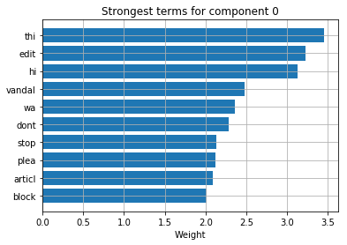
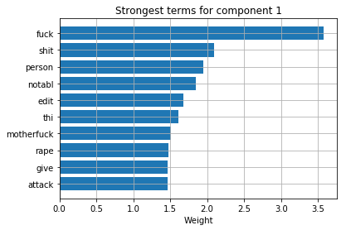
Number of topics selection

Slide 12


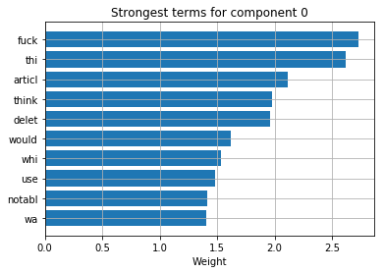
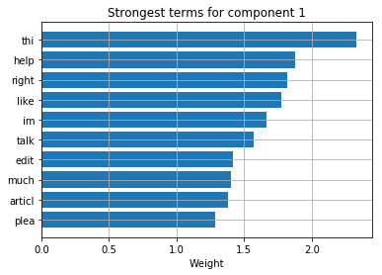
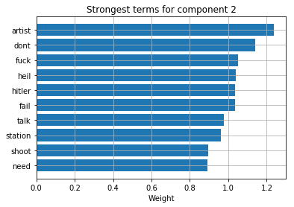
Number of topics selection

Slide 13
Application Demonstration

Slide 14
Thank you for your attention! Questions?

